Slide 1
Knowledge Graph and Deep Learning
Tsinghua University
2019 Summer School on Deep Learning
Zhiyuan Liu
liuzy@tsinghua.edu.cn

Slide 2
What Is Knowledge Graph?

Slide 3

An Introduction from Google

Slide 4
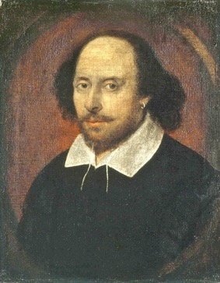
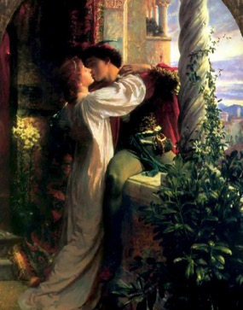
Structural Knowledge
write
head entity
relation
tail entity
Notes:
A typical knowledge graph usually represents knowledge with triple facts.
For example, the knowledge “William Shakespeare writes Romeo and Juliet” is represented in the form of triple as follows.
William Shakespeare is the head entity, Romeo and Juliet is the tail entity, and works_written is the relation.

Slide 5
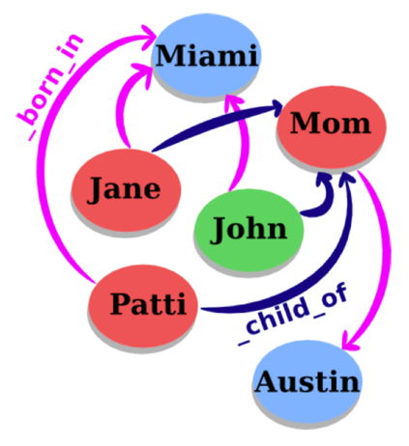
Entities and Relations
Knowledge structured as graph
Each node = an entity
Each edge = a relation
Fact: (head, relation, tail)
head = subject entity
relation = relation type
tail = object entity
Typical KGs
WordNet: Linguistic KG
Freebase: World KG

Slide 6




Knowledge Graph Examples
Notes:
Here are some widely-used large-scale knowledge graphs, including Freebase (now it has been combined into Wikidata), Dbpedia (which is mainly extracted from Wikipedia), YAGO. Even WordNet could be considered as a knowledge graph.

Slide 7






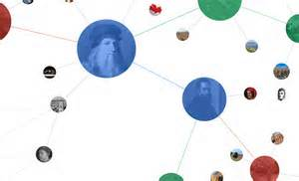
Milestone
Wikipedia
Cyc
WordNet
HowNet
High-Quality Data Source
5 million concepts
muilti-lingual
rich structural data:
Infobox，table，
list，category…
1985
1990
2005-2010

Slide 8
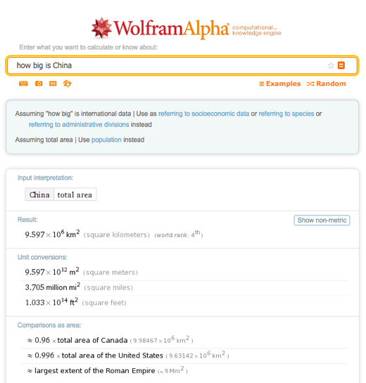
KG Application: Question Answering

Slide 9
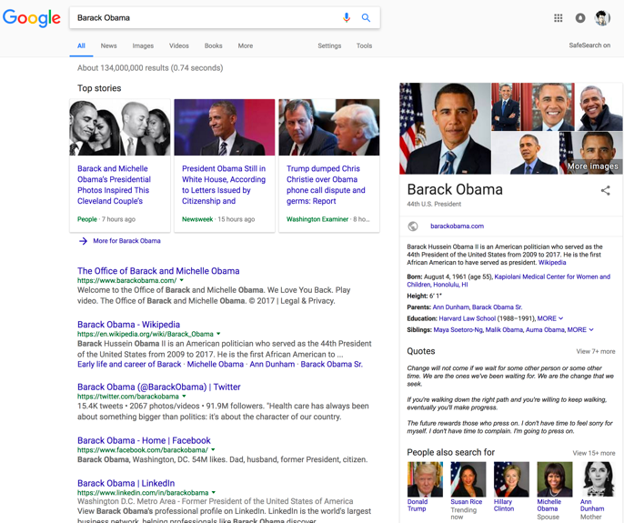
KG Application: Search Engine
Notes:
在谷歌中，搜索obama，在右侧中可以显示出与之有关的各种属性，例如出生时间，地点，配偶等关系。以往的检索的内容只能够提供包含字符串“obama”的网页，信息需要用户自己去阅读，这种基于知识图普的检索方式，大大提升了效率和准确性。

Slide 10
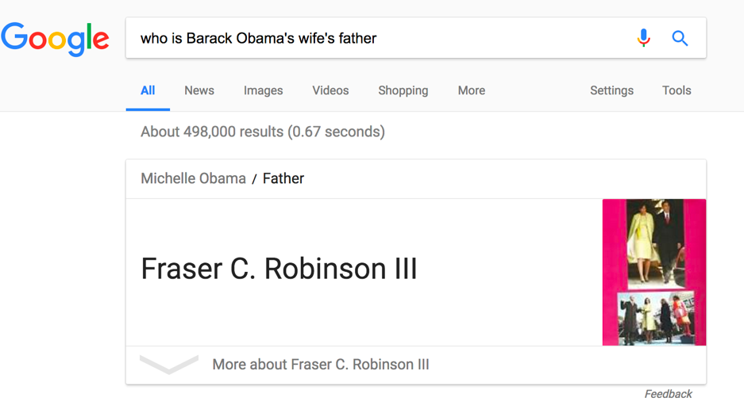
KG Application: Inference

Slide 11
Knowledge Representation Learning

Slide 12
ML = Representation + Objective + Optimization
Yoshua Bengio. Deep Learning of Representations. AAAI 2013 Tutorial.

Slide 13

What is Representation Learning
1-hot Representation
Foundation of Bag-of-Words Model
star
[0, 0, 0, 0, 0, 0, 0, 0, 1, 0, 0, 0, 0, …]
sun
[0, 0, 0, 0, 0, 0, 0, 1, 0, 0, 0, 0, 0, …]
sim(star, sun) = 0

Slide 14
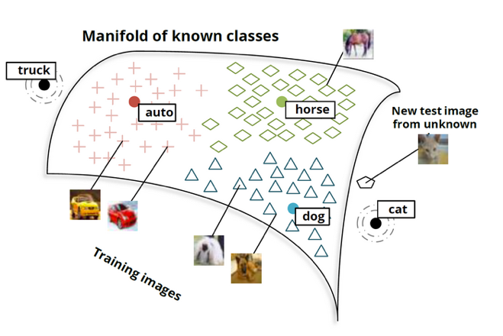
What is Representation Learning
Distributed Representation / Embeddings
Objects are represented as dense, real-valued, and low-dimensional vectors

Slide 15
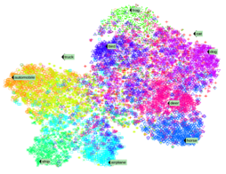
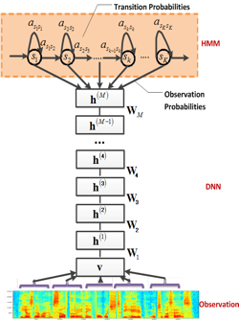
Main Ideas of RL
Distributed Representation
Embeddings
Dense, real-valued, and low-dimensional vectors
Hierarchical Network Structure
Corresponding to hierarchical real world
Abstraction and generalization

Slide 16

RL for NLP / KG
Alleviate sparsity issue in large-scale NLP
Enable knowledge transfer across domains and objects
Knowledge
Semantic Parsing
Document
Syntactic Parsing
Sentence
Lexical Analysis
Word
Unified Semantic Space

Slide 17
RL4KG
Typical representations for KG
Symbolic triples (RDF)
Cannot efficiently measure semantic relatedness of entities
How: Encode KGs into low-dimensional vector spaces

Slide 18
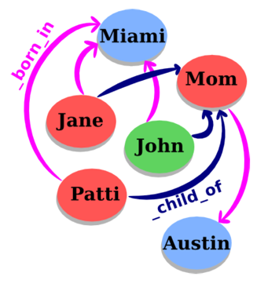
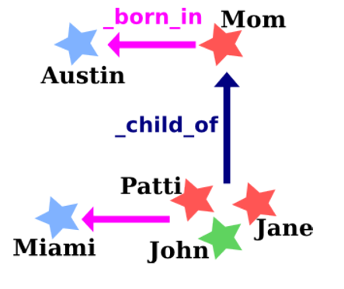
TransE
For each triple (head, relation, tail), relation as a translation from head to tail
Learning objective: h + r = t

Slide 19
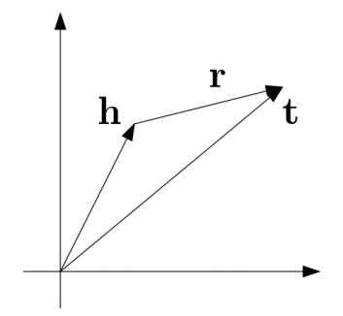
TransE
For each triple (head, relation, tail), relation as a translation from head to tail
Learning objective: h + r = t

Slide 20
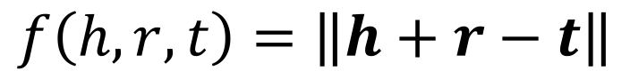
Objective Function
Energy Function
For correct (h, r, t)，requires h + r = t
$$f\left(h, r, t\right)=\left\|h+r−t\right\|$$

Slide 21
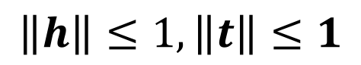
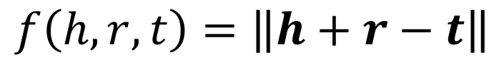
Objective Function
Energy
Function
$$f\left(h, r, t\right)=\left\|h+r−t\right\|$$
Objective
Function
where
w.r.t
$$\left\|h\right\|≤1, \left\|t\right\|≤1$$
triple sets in KG
negative triple sets not in KG

Slide 22

Entity Prediction
WALL-E
_has_genre
?
h + r = ?

Slide 23
Entity Prediction
WALL-E
_has_genre
Animation
Computer animation
Comedy film
Adventure film
Science Fiction
Fantasy
Stop motion
Satire
Drama
Connecting
h + r = t

Slide 24
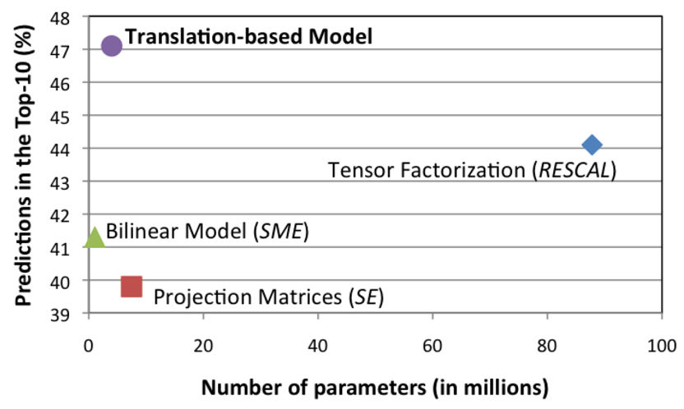
Prediction Performance
Dataset: Freebase15K

Slide 25
TransE Examples
Entity | Tsinghua_University | A.C._Milan
1 | University_of_Victoria | Inter_Milan
2 | St._Stephen's_College,_Delhi | Celtic_F.C.
3 | University_of_Ottawa | FC_Barcelona
4 | University_of_British_Columbia | Genoa_C.F.C.
5 | Peking_University | Udinese_Calcio
6 | Utrecht_University | Real_Madrid_C.F.
7 | Dalhousie_University | FC_Bayern_Munich
8 | Brasenose_College,_Oxford | Bolton_Wanderers_F.C.
9 | Cardiff_University | Borussia_Dortmund
10 | Memorial_University_of_Newfoundland | Hertha_BSC_Berlin

Slide 26
TransE Examples
Entity | China | Barack_Obama | Apple
1 | Japan | George_W._Bush | Onion
2 | Taiwan | Nancy_Pelosi | Strawberries
3 | South_Korea | John_Kerry | Avocado
4 | Argentina | Hillary_Rodham_Clinton | Pear
5 | North_Korea | Al_Gore | Cabbage
6 | Hungary | George_H._W._Bush | Broccoli
7 | Israel | John_McCain | Egg
8 | Australia | Colin_Powell | Cheese
9 | Iceland | Bill_Clinton | Bread
10 | Hong_Kong | Charles_B._Rangel | Tomato

Slide 27
TransE Examples
Relation | /people/person/nationality | /location/location/contains
1 | /people/person/places_lived | /base/aareas/schema/administrative_area/administrative_children
2 | /people/person/place_of_birth | /location/country/administrative_divisions
3 | /people/person/spouse_s | /location/country/first_level_divisions
4 | /base/popstra/celebrity/vacations_in | /location/country/capital
5 | /government/politician/government_positions_held | /award/award_nominee/award_nominations
6 | /people/deceased_person/place_of_death | /location/administrative_division/capital
7 | /olympics/olympic_athlete/country | /location/us_county/county_seat
8 | /olympics/olympic_athlete/medals_won | /base/aareas/schema/administrative_area/capital
9 | /music/artist/origin | /location/us_county/hud_county_place
10 | /people/person/employment_history | /award/award_winner/awards_won

Slide 28
TransE Examples
Head | China | Barack_Obama
Relation | /location/location/adjoin | /education/education/institution
1 | Japan | Harvard_College
2 | Taiwan | Massachusetts_Institute_of_Technology
3 | Israel | American_University
4 | South_Korea | University_of_Michigan
5 | Argentina | Columbia_University
6 | France | Princeton_University
7 | Philippines | Emory_University
8 | Hungary | Vanderbilt_University
9 | North_Korea | University_of_Notre_Dame
10 | Hong_Kong | Texas_A&M_University

Slide 29
TransE Examples
Head | Stanford_University | Apple | Titanic
Relation | /education/educational_institution/students_graduates | /food/food/nutrients | /film/film/genre
1 | Steven_Spielberg | Lipid | War_film
2 | Ron_Howard | Protein | Period_piece
3 | Stan_Lee | Valine | Drama
4 | Barack_Obama | Tyrosine | History
5 | Milton_Friedman | Serine | Biography
6 | Walter_F._Parkes | Iron | Film_adaptation
7 | Michael_Cimino | Cystine | Adventure_Film
8 | Gale_Anne_Hurd | Pantothenic_acid | Action_Film
9 | Bryan_Singer | Vitamin_A | Political_drama
10 | Aaron_Sorkin | Sugar | Costume_drama

Slide 30
Key Challenges in RL4KG
Modeling Complex Relations
Fusion of External Information and KG
Modeling Relational Paths
Modeling KG with Confidence

Slide 31
Modeling Complex Relations

Slide 32



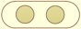

Complex Relations
1-to-N, N-to-1, N-to-N relations
(USA, _president, Obama)
(USA, _president, Bush)
Obama
USA
_president
?
$$≈$$
+
?
Bush

Slide 33
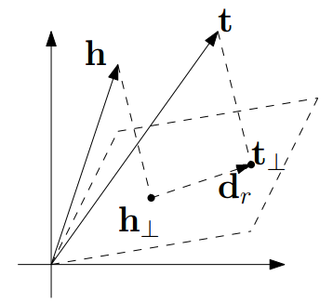
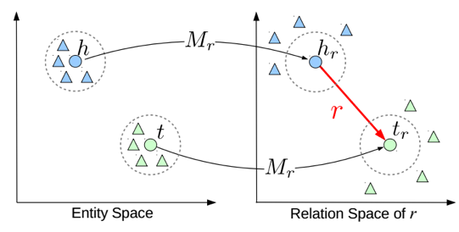
Complex Relations
Build relation-specific entity embeddings
TransH
TransR
Wang, et al. (2014). Knowledge graph embedding by translating on hyperplanes. AAAI.
Lin, et al. (2015). Learning entity and relation embeddings for knowledge graph completion. AAAI.

Slide 34
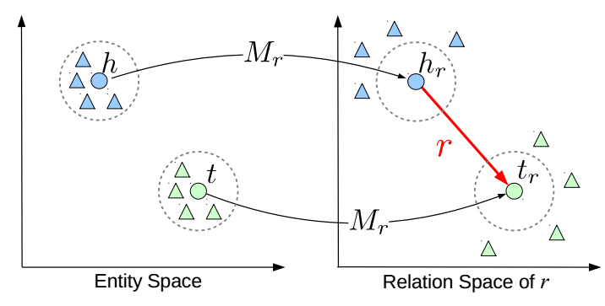
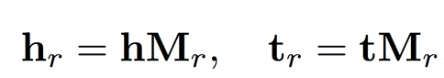
TransR

Slide 35
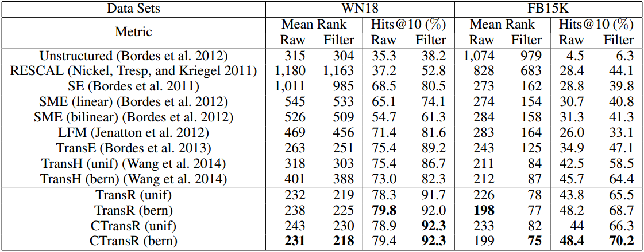
Link Prediction Results

Slide 36
Examples
Head Entity | Titanic
Relation | /film/film/genre
Model | TransE | TransH | TransR
1 | War_film | Drama | Costume_drama
2 | Period_piece | Romance_Film | Drama
3 | Drama | Costume_drama | Romance_Film
4 | History | Film_adaptation | Period_piece
5 | Biography | Period_piece | Epic_film
6 | Film_adaptation | Adventure_Film | Adventure_Film
7 | Adventure_Film | LGBT | LGBT
8 | Action_Film | Existentialism | Film_adaptation
9 | Political_drama | Epic_film | Existentialism
10 | Costume_drama | War_film | War_film

Slide 37
Examples
Head | University_of_Cambridge
Relation | /education/education/student
Model | TransE | TransH | TransR
1 | John_Cleese | Stephen_Fry | David_Attenborough
2 | Samuel_Beckett | David_Attenborough | Stephen_Fry
3 | Harold_Pinter | Ralph_Vaughan_Williams | Stephen_Hawking
4 | Virginia_Woolf | Alan_Bennett | Ralph_Vaughan_Williams
5 | Graham_Chapman | Francis_Bacon | Alan_Bennett
6 | Philip_Pullman | Julian_Fellowes | Julian_Fellowes
7 | Ian_McEwan | Hugh_Bonneville | Ernest_Rutherford
8 | Douglas_Adams | Graham_Chapman | Jonathan_Lynn
9 | Terry_Gilliam | Miriam_Margolyes | Tom_Hollander
10 | Richard_Dawkins | Stephen_Hawking | Chris_Weitz

Slide 38
TransD
TransD builds relation-specific entity embeddings with projection matrices related not only to relation but also head/tail entities.
Notes:
在TransR的基础上考虑头尾实体的影响

Slide 39
KG2E
To specially consider the (un)certainties of entities and relations , KG2E models each relations and entities with Gaussian Distribution.
Notes:
用Gaussian Embedding考虑不同实体、关系的不确定性，如国籍不确定性大（涉及更多不同实体）

Slide 40
NTN
NTN models KG with a Neural Tensor Network and represents entities via word vectors.

Slide 41
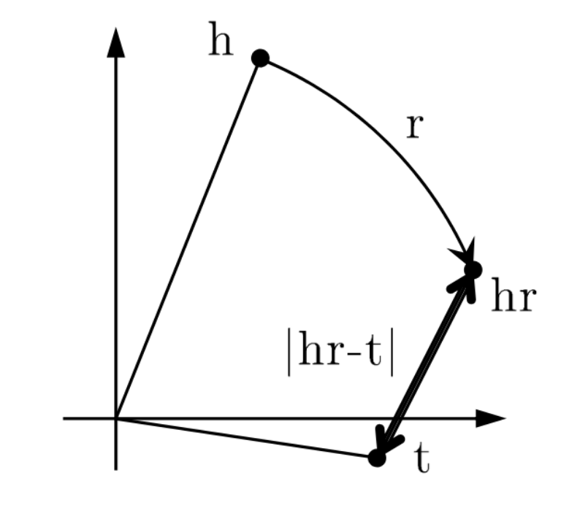
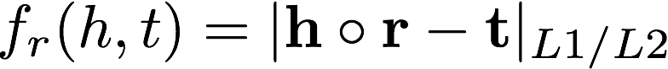
RotateE
Model each relation as a rotation from the head entity to the tail entity in the vector space

Slide 42
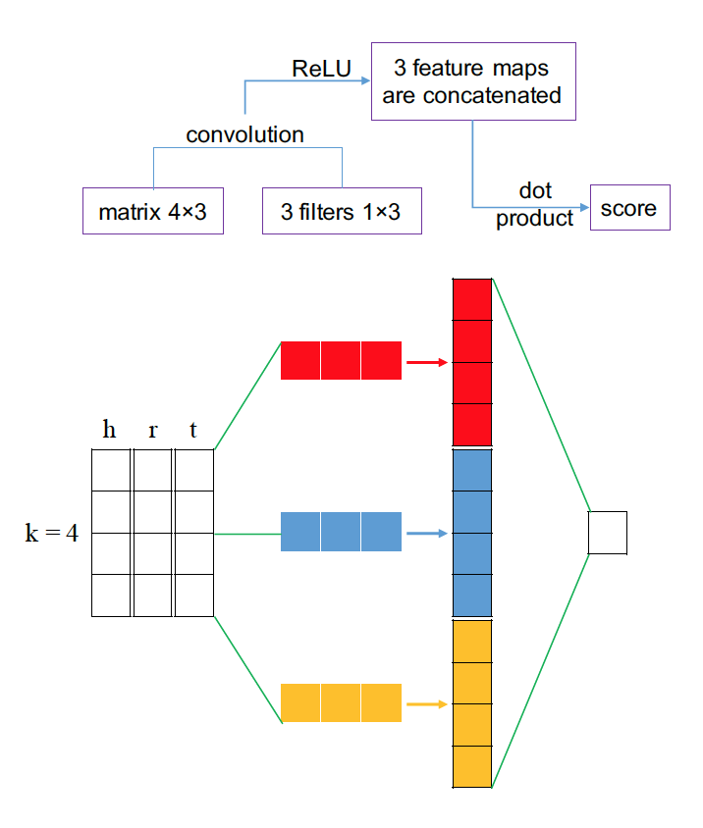
ConvKB
Model relational facts with CNN

Slide 43
Other Models
TranSparse uses sparse projection matrices to deal with the issue of entities and relations are heterogeneous and unbalanced
Holographic Embeddings uses the circular correlation to combine the expressive power of the tensor product with the efficiency and simplicity of TransE.
Complex Embeddings employs eigenvalue decomposition model which makes use of complex valued embeddings.
Ji, et al. (2016) Knowledge Graph Completion with Adaptive Sparse Transfer Matrix. AAAI.
Nichkel, et al. (2015) Holographic Embeddings of Knowledge Graphs. Arxiv.
Trouillon, et al. (2016) Complex embeddings for simple link prediction. Arxir.

Slide 44
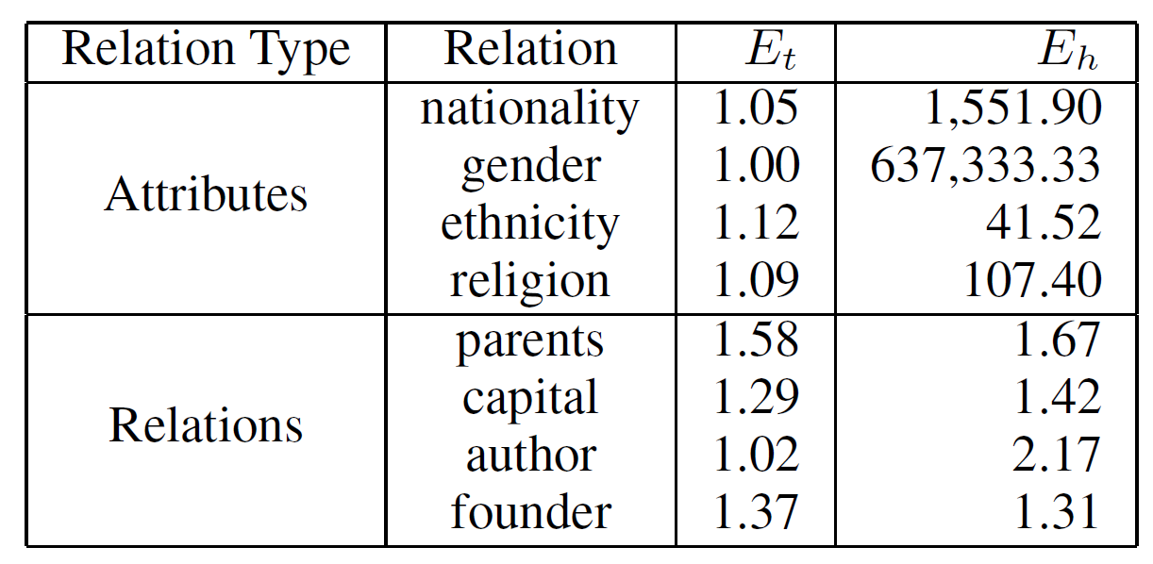
KR-EAR
Relational Facts in Knowledge Graph
Entity Attributes
Relations between Entities

Slide 45
KR-EAR
Relational Triple Encoder
Attributional Triple Encoder
Notes:
Attributional Triple Encoder分类模型
Relational Triple Encoder：KRL模型

Slide 46


Summary
TransE is too simple to handle complex relations well
1-N, N-1, N-N
TransA，TransD，TransE，TransG，TransH，TransR, KG2E, TranSparse, Hole

Slide 47
Fusion of External Information and KG

Slide 48
Any Other Information We Can Use?

Slide 49

Complicated World
Actinidia polygama
puma
cat
tiger
lion
The domestic cat (Latin: Felis catus) or the feral cat (Latin: Felis silvestris catus) is a small, typically furry, carnivorous mammal. They are often called house cats when kept as indoor pets or simply cats when there is no need to distinguish them from other felids and felines
Notes:
世界是多元而复杂的，可以从各个方面抽取信息，对世界更准确地建模
多源信息包括KG、文本、类别信息、图像等（具体实例）
构建知识图谱的跨模态表示，便于在其他多模态任务中引入知识的信息

Slide 50
Three Types of Information
Text Information
Construct representation with the corresponding entity descriptions, entity text
Structure Information
Construct representation from the corresponding entity hierarchical structure
Image Information
Construct representation from the corresponding entity images
Notes:
三种表示

Slide 51
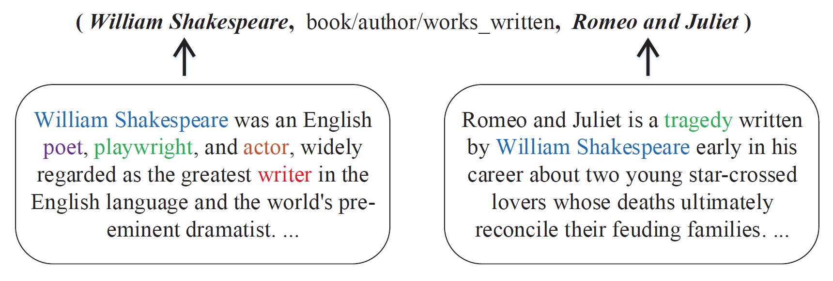
Entity Descriptions
KG contains rich information besides network structure

Slide 52
Description-Embodied RL4KG
Enhance entity representation with descriptions
Model descriptions with CNN
Xie, et al. (2016). Representation Learning of Knowledge Graphs with Entity Descriptions. AAAI.

Slide 53
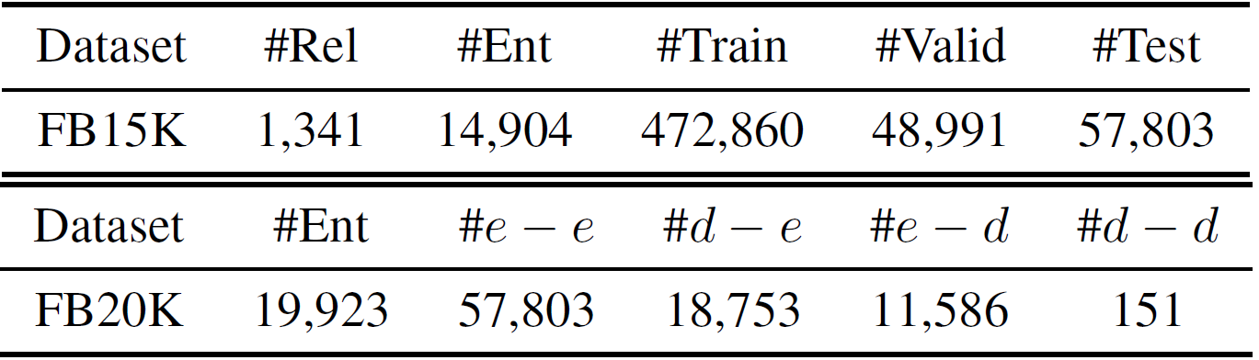
Datasets
FB15K: A typical KG dataset extracted from Freebase (Bordes et al., 2013)
FB20K: A new dataset based on FB15K with new entities for zero-shot scenario
Notes:
FB15K, a classical dataset
FB20K, specially for zero-shot test.

Slide 54
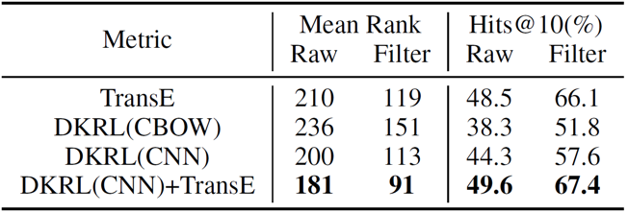
Knowledge Completion
Evaluation results on entity prediction
Notes:
第一种评测任务：知识补全/链接预测（举例），对应于QA中的实际问题
两种评测方法：(1) Mean rank: the average rank of correct answer; (2) Hits@10: it is the percentage of the correct answer ranks in top 10.
Raw and Filter
实验结果：
1、融合了实体信息的模型结果，能得到了最佳的结果
2、CNN更好地对描述建模

Slide 55
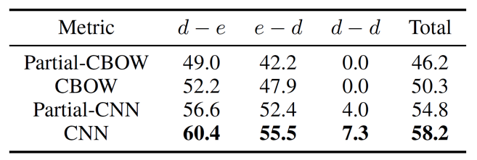
Knowledge Completion in Zero-Shot
DKRL can well predict relations between novel entities with only descriptions
* d-e indicates the embeddings of head entity are obtained from descriptions via CNN
Notes:
zero-shot scenario.
传统的基于KG结构的KRL，无法表示新实体，然而我们的方法可以根据新实体的文本信息，自动学习实体的知识表示
Here, d-e, d means the head is a new entity, and e means the tail is in training set
Partial-CBOW means if an entity appears in training set, we use the SBR, and CBOW means for all entities we use DBR.
实验结果：
1、CNN比CBOW好，KRL都用基于描述的会更好
2、DKRL能够处理新实体，结果与实体在训练集中的效果接近

Slide 56
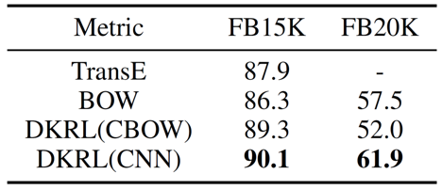
Entity Classification
Evaluation results on entity classification
Notes:
第二个任务：实体分类
每个实体有多个类别，使用MAP作为评价指标
实验结果：
1、BOW是纯使用文本特征+LR的结果
2、CNN取得最好结果，因为它既使用了KG的信息，也使用了文本的信息

Slide 57
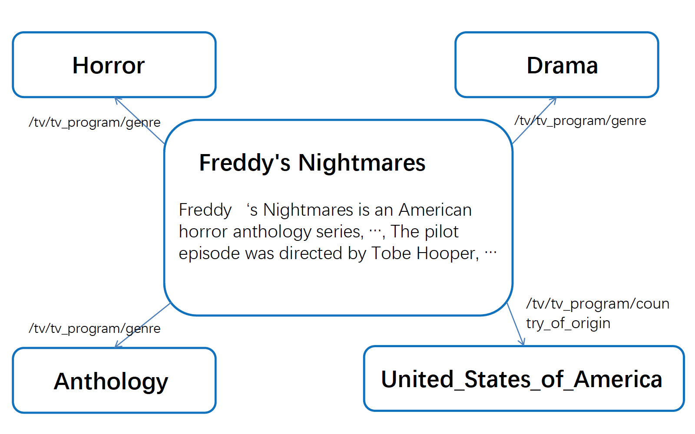
Examples

Slide 58
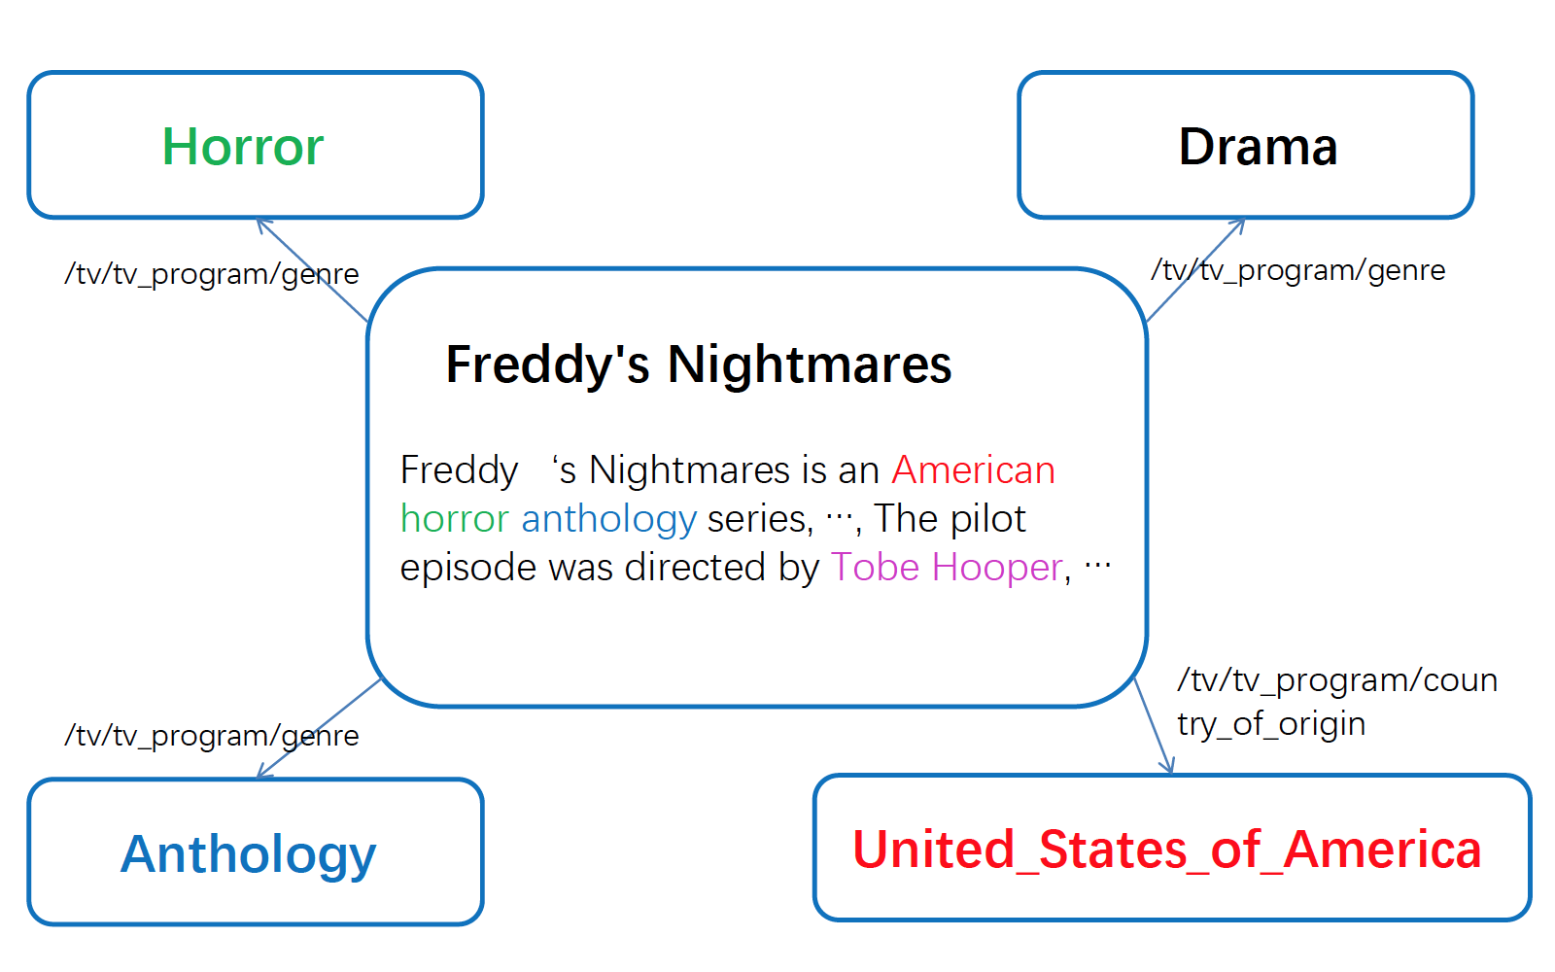
Examples

Slide 59
Fusion of Text and KG
Wu, et al. (2016). Knowledge Representation via Joint Learning of Sequential Text and Knowledge Graphs. arXiv:1609.07075

Slide 60
Fusion of Text and KG

Slide 61
Examples

Slide 62
Fusion of Text and KG
Relation Prediction from KG
Relation Extraction from Text
r ~ t-h
Founder
Bill Gates
Microsoft
Bill Gates
was the co-founder and CEO of
Microsoft

Slide 63
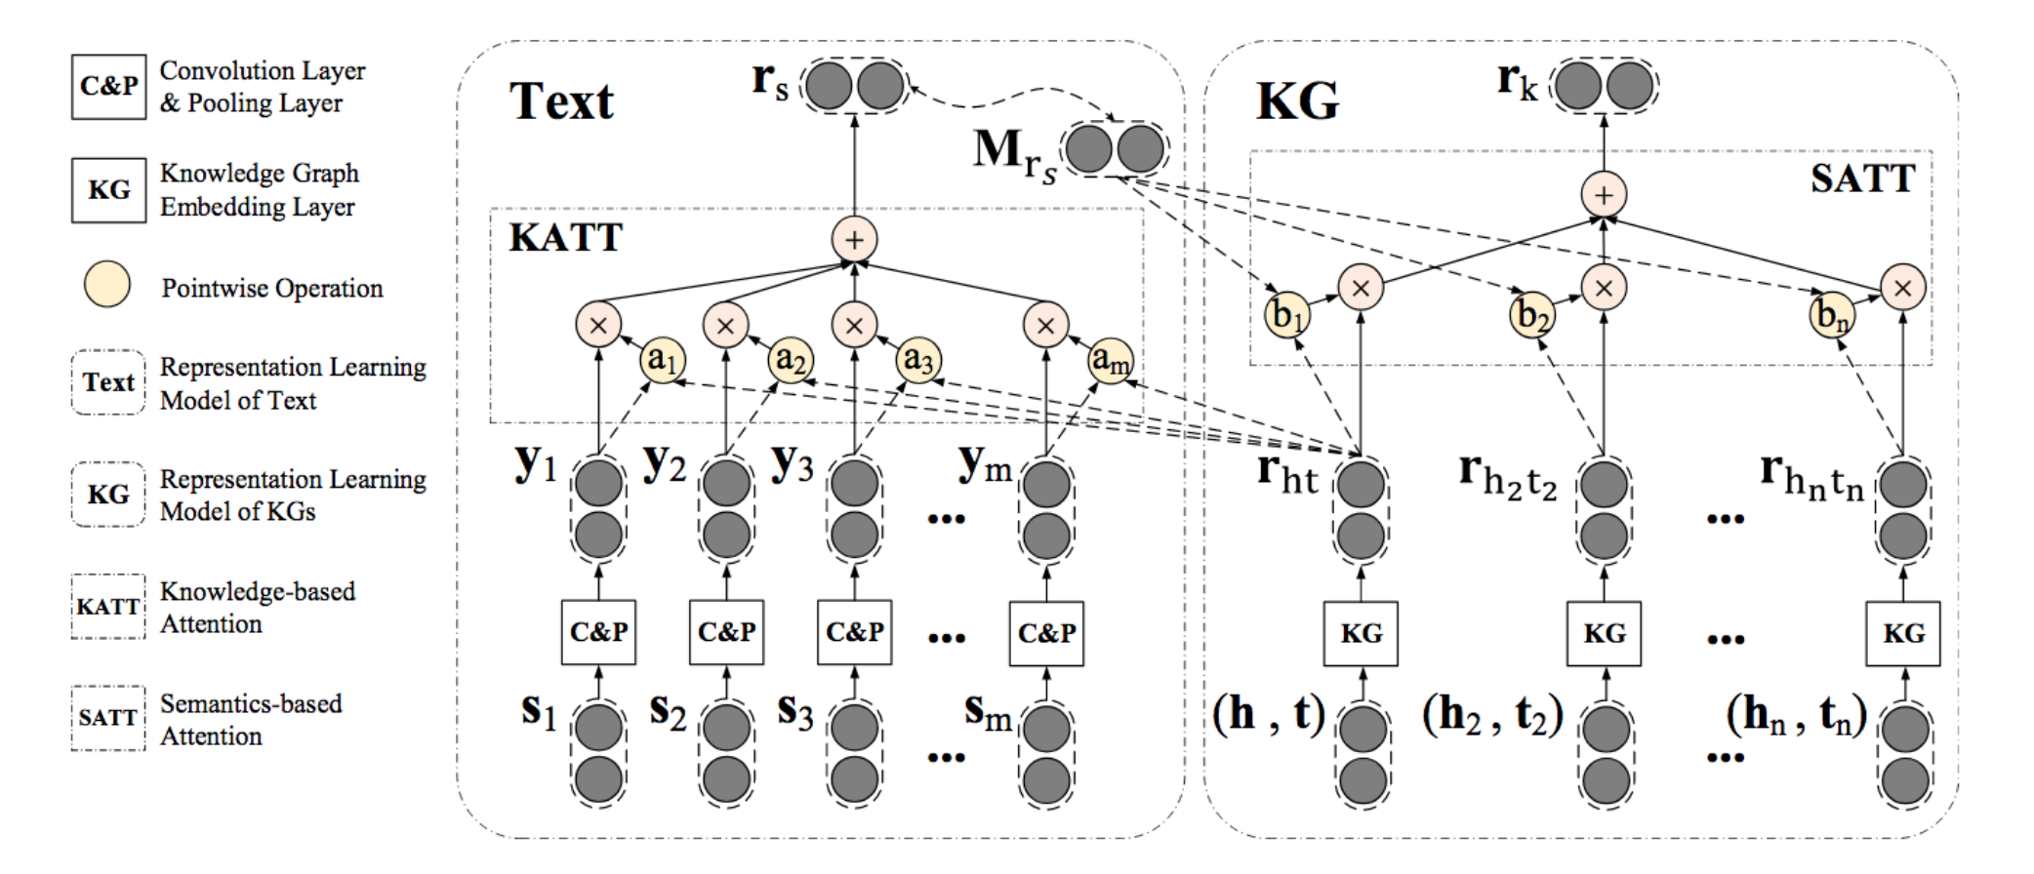
Fusion of Text and KG
Joint representation learning of KGs and text with the mutual attention
Han, et al. (2018). Neural Knowledge Acquisition via Mutual Attention between Knowledge Graph and Text. AAAI.

Slide 64
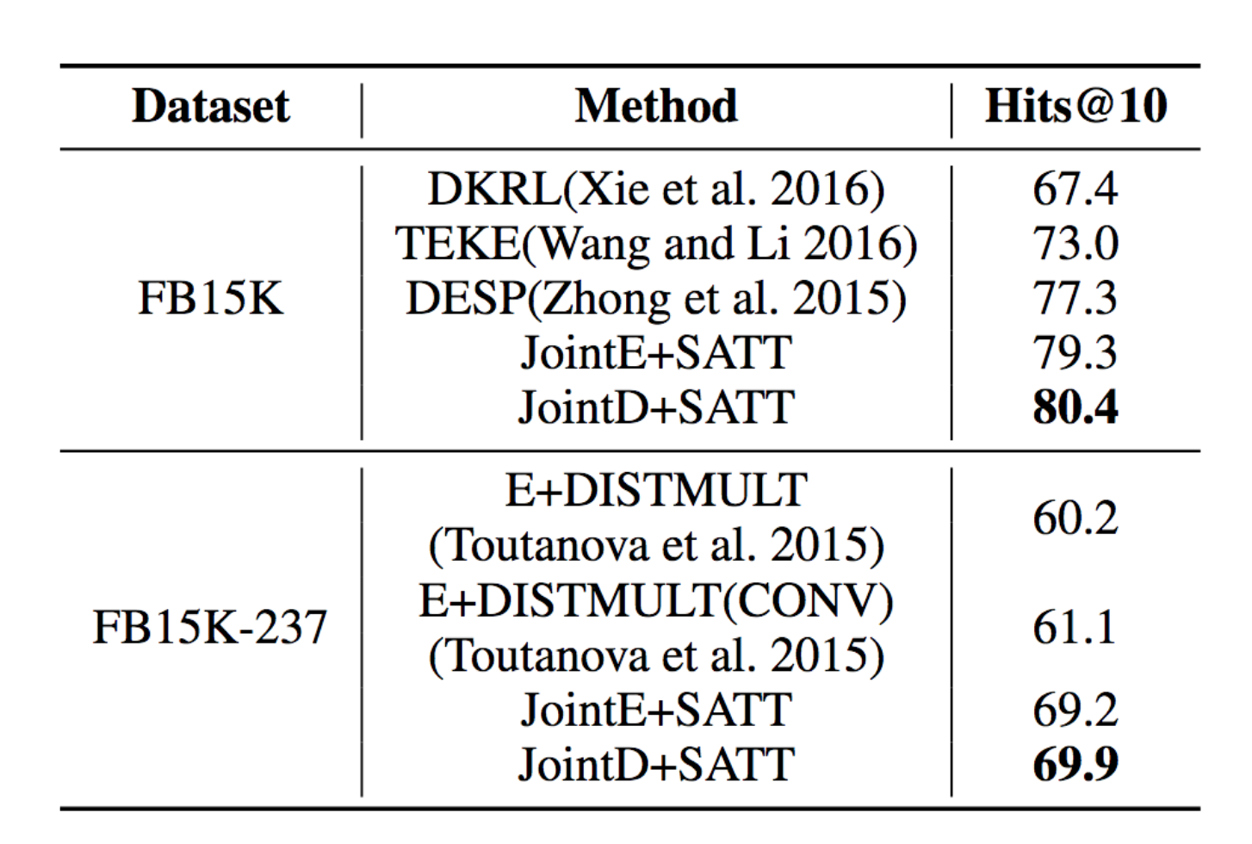
Entity Prediction

Slide 65
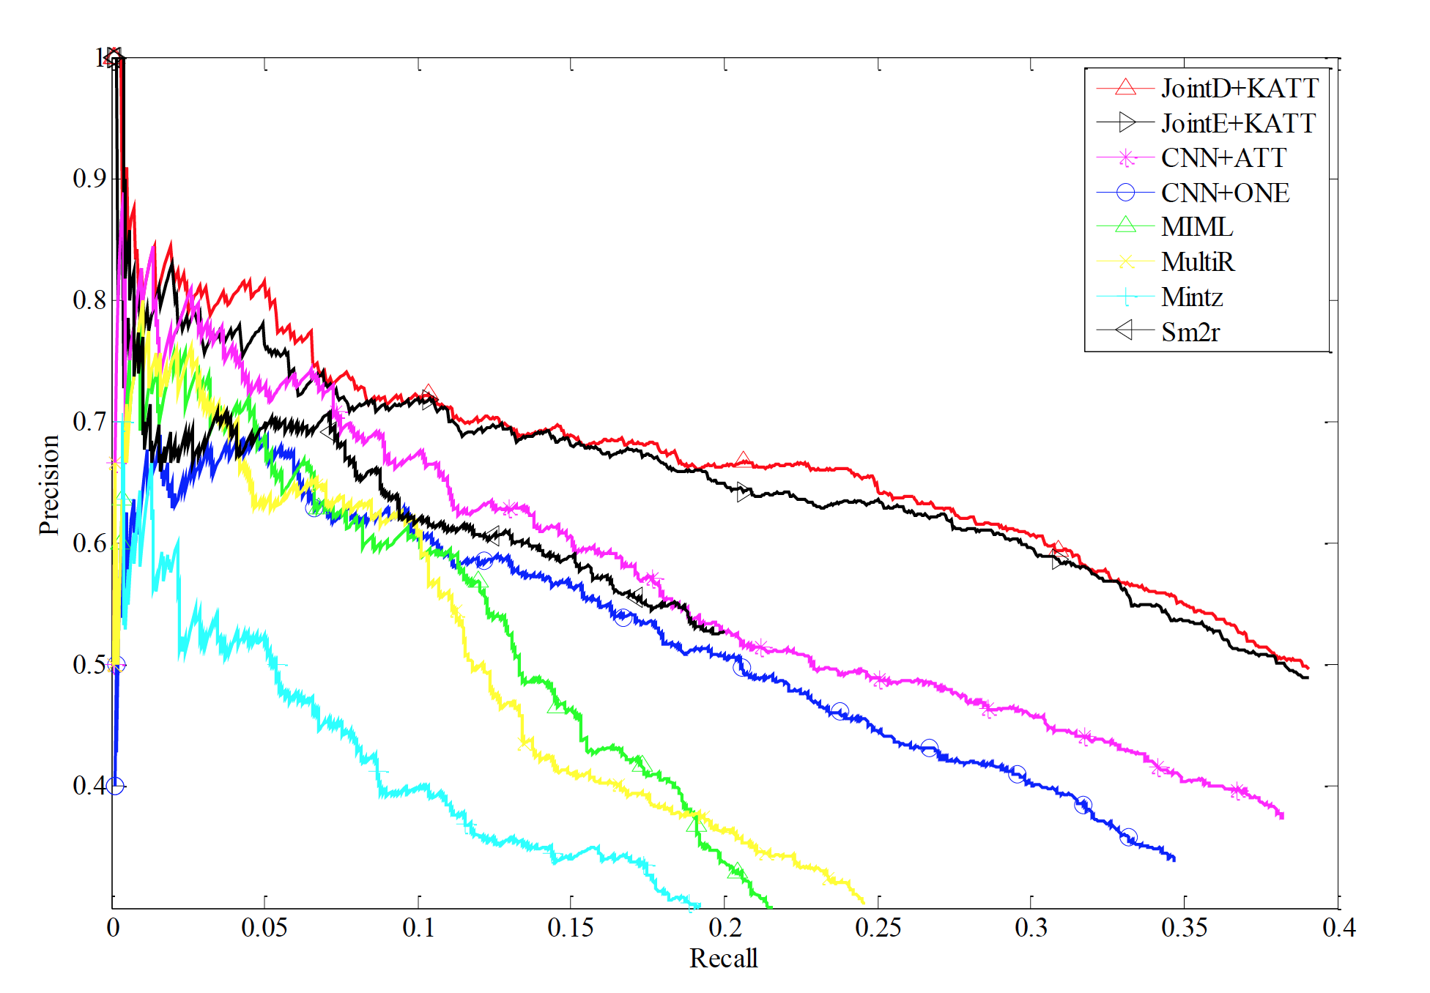
Relation Extraction

Slide 66
Three Types of Information
Text Information
Construct representation with the corresponding entity descriptions, entity text
Structure Information
Construct representation from the corresponding entity hierarchical structure
Image Information
Construct representation from the corresponding entity images
Notes:
三种表示

Slide 67
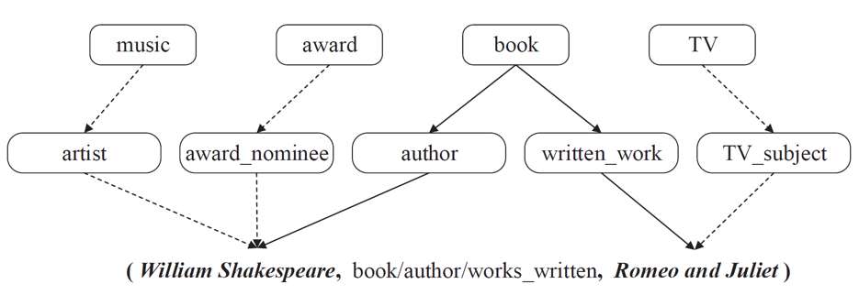
Hierarchical Types
Xie, et al. (2016). Representation Learning of Knowledge Graphs with Hierarchical Types. IJCAI.

Slide 68
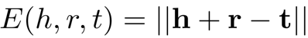
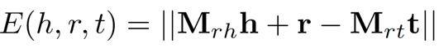
Enhanced Energy Function

Slide 69
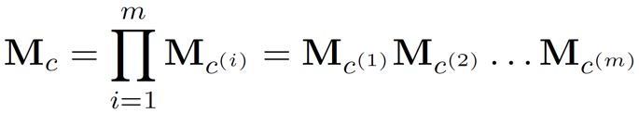
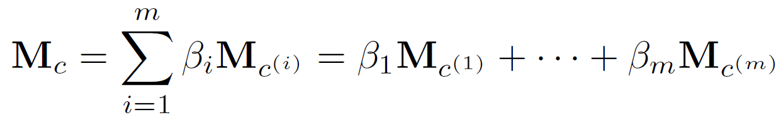
Hierarchical Type Encoders
Recursive Hierarchy Encoder (RHE)
Weighted Hierarchy Encoder (WHE)

Slide 70
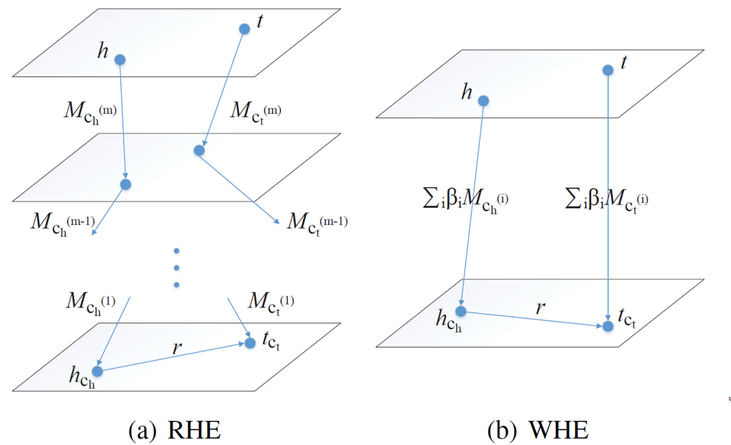
Hierarchical Type Encoders

Slide 71
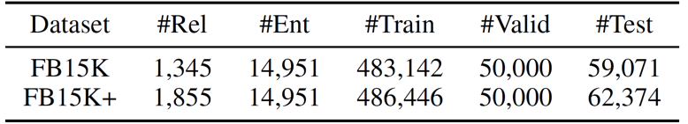
Datasets
FB15k: A typical KG dataset extracted from Freebase (Bordes et al., 2013)
FB15k+: A new dataset based on FB15K with low-frequent relations
Notes:
FB15K, a classical dataset
FB20K, specially for zero-shot test.

Slide 72
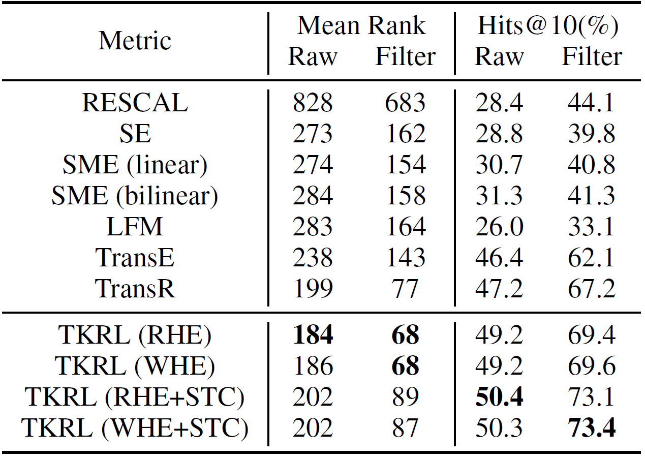
Entity Prediction

Slide 73
Results on Long-Tail Distribution
Hierarchical types help the performance on those long-tail entities
Prior knowledge is critical for sparse data

Slide 74
Three Types of Information
Text Information
Construct representation with the corresponding entity descriptions, entity text
Structure Information
Construct representation from the corresponding entity hierarchical structure
Image Information
Construct representation from the corresponding entity images
Notes:
三种表示

Slide 75
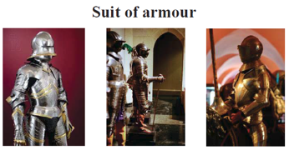
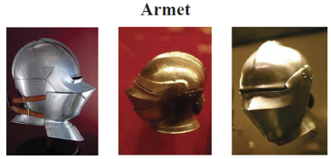
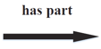
Visual Information in Images
(Suit of armour, has_part, Armet)
Xie, et al. (2017). Image-embodied Knowledge Representation Learning. IJCAI.

Slide 76
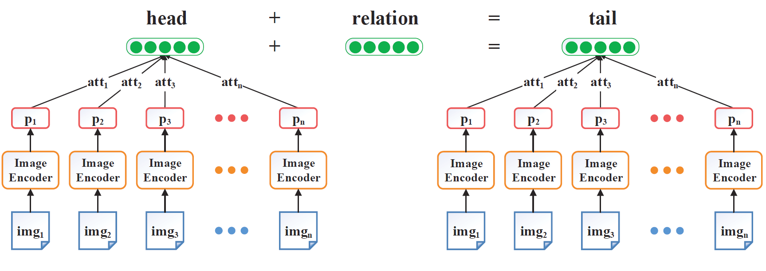
Overall Architecture

Slide 77
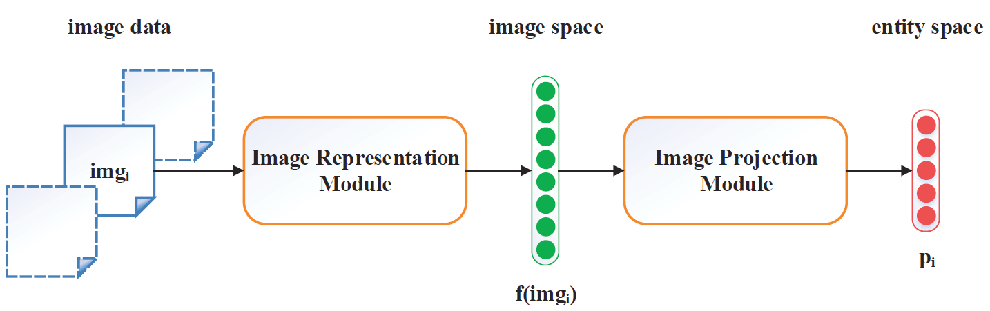
Image Encoder
Notes:
Image Representation Module: Pre-trained AlexNet

Slide 78

Attention
An entity usually has multiple images
We want to select more representative and informative images to construct the entity representations

Slide 79

Entity Prediction

Slide 80

Triple Classification

Slide 81

Semantic Regularities of Images

Slide 82

Power of Attention

Slide 83
Summary
Information in KGs and out of KGs are complementary
Joint RL for text and KG is important for relation extraction and knowledge representation

Slide 84
Modeling Relational Paths

Slide 85

Relation Paths
Complex inference patterns between relations

Slide 86

Relation Paths for Relation Prediction
Path Ranking Algorithm
Lao, et al. (2011). Random walk inference and learning in a large scale knowledge base. EMNLP.

Slide 87

Path-based TransE
Lin, et al. (2015). Modeling Relation Paths for Representation Learning of Knowledge Bases. EMNLP.

Slide 88

Path-based TransE
Semantic composition: add, multiply, RNN
Lin, et al. (2015). Modeling Relation Paths for Representation Learning of Knowledge Bases. EMNLP.

Slide 89

Entity Prediction Results
+35%

Slide 90

Relation Prediction Results
+10%

Slide 91
Examples
Head Entity | Barack_Obama
Relation | /education/education/institution
Model | TransE | PTransE
1 | Harvard_College | Columbia_University
2 | Massachusetts_Institute_of_Technology | Occidental_College
3 | American_University | Punahou_School
4 | University_of_Michigan | University_of_Chicago
5 | Columbia_University | Stanford_University
6 | Princeton_University | Princeton_University
7 | Emory_University | University_of_Pennsylvania
8 | Vanderbilt_University | University_of_Virginia
9 | University_of_Notre_Dame | University_of_Michigan
10 | Texas_A&M_University | Yale_University
Notes:
TransE：不同大学向量相似无法区分
PTransE：通过path可以区分

Slide 92
Examples
Head Entity | Stanford_University
Relation | /education/educational_institution/students_graduates
Model | TransE | PTransE
1 | Steven_Spielberg | Raymond_Burr
2 | Ron_Howard | Ted_Danson
3 | Stan_Lee | Delmer_Daves
4 | Barack_Obama | D.W._Moffett
5 | Milton_Friedman | Gale_Anne_Hurd
6 | Walter_F._Parkes | Jack_Palance
7 | Michael_Cimino | Kal_Penn
8 | Gale_Anne_Hurd | Kurtwood_Smith
9 | Bryan_Singer | Alexander_Payne
10 | Aaron_Sorkin | Richard_D._Zanuck

Slide 93

Path Query Answering
Query
Where are Tad Lincoln’s parents located
Guu, et al. (2015). Traversing Knowledge Graphs in Vector Space. EMNLP.

Slide 94

Summary
Relation paths contain rich inference patterns about knowledge
More complex inference patterns should be taken into consideration

Slide 95
Modeling KG with Confidence

Slide 96

Confidence-aware RL4KG
Automatic mechanism and crowdsourcing lead to noise in KG
relation extraction model on benchmark achieves only around 60% precision when the recall is 20%
Xie, et al. (2018). Does William Shakespeare REALLY Write Hamlet? Knowledge RepresentationLearning with Confidence. AAAI.
Notes:
低置信度的三元组在学习中会相应收到打压，最终使得带有噪声的知识图谱中的知识表示向量能够学得更好，同时减少噪声和错误带来的影响。

Slide 97

Confidence-aware RL4KG
Local triple confidence
Notes:
根据一个三元组本身进行判断，三元组根据|h+r-t|距离进行判断

Slide 98

Confidence-aware RL4KG
Global path confidence
Notes:
根据全局信息（relational path)进行判断

Slide 99

Noise Detection
CKRL outperform TransE in different proportions of noise
Notes:
Datasets FB15K-N1 FB15K-N2 FB15K-N3
#Neg triple 46,408 93,782 187,925

Slide 100
Other Key Challenges in RL4KG
Online and fast learning for large-scale KGs
Large-scale KGs are sparse, existing models cannot learn good representation for infrequent entities and relations
Learning orders of triples are important for fast RL4KG
Curriculum Learning

Slide 101
Other Key Challenges in RL4KG
Online and fast learning for large-scale KGs
Large-scale KGs are sparse, existing models cannot learn good representation for infrequent entities and relations
Learning orders of triples are important for fast RL4KG
Curriculum Learning

Slide 102
Open Source Codes
https://github.com/thunlp
OpenKE: TransE、TransH、TransR、PTransE

Slide 103



Take Home Message
DL4KG is a promising approach to construction and application of KGs
DL4KG is still a rising research area, there are many open problems
Learn from the generalization & abstraction abilities of human
Zero / One shot learning
Joshua B. Tenenbaum, et al. (2011) How to grow a mind: statistics, structure, and abstraction. Science. Lake, et al. (2015) Human-level concept learning through probabilistic program induction. Science.

Slide 104
Outlook
DL & KG will bring a revolution to NLP
Knowledge-Guided Language Understanding
Sentence: Question Answering, Conversation
Document: Summarization, Reading Comprehension
Knowledge-Guided Language Generation
Legal, Patent, Finance, Science

Slide 105



Recommended Books
Machine Learning

Slide 106



Recommended Books
NLP and Knowledge Graphs

Slide 107
Thanks!
http://nlp.csai.tsinghua.edu.cn/~lzy
liuzy@tsinghua.edu.cn

Slide 108
How to Get Knowledge from Text ?

Slide 109
Information Extraction
Understand and gather information from unstructured and semi-structured documents
Plain texts
Emails
Web pages
Automatically extract structured representations of relevant information
Named entities
Relational facts
Events

Slide 110
Information Extraction
Important sub-tasks
Named Entity Recognition (NER)
Relation Extraction (RE)
Unstructured Text
Obama was born in Hawaii in 1961.
Named Entity Recognition
Obama was born in Hawaii in 1961 .
PER
LOC
TIME
Relation Extraction
(Obama, Place of birth, Hawaii)
(Obama, Date of birth, 1961)
Structured facts

Slide 111
Information Extraction
Goals: organize key information so that
It is useful for people to
Find the proteins mentioned in a biomedical journal article
Identify the companies mentioned in a stock report
Populate knowledge bases
Allow further inferences over structured knowledge
Reading comprehension models (RC)
Question answering on knowledge bases (KBQA)
Search engines

Slide 112
Outline
Named Entity Recognition
Relation Extraction
Relation Extraction
Open-domain Relation Extraction
Event Extraction

Slide 113
Named Entity Recognition
Named Entity Recognition:
Locate and classify named entity mentions in unstructured text into pre-defined categories, such as person names, locations, etc.
Unstructured Text
Obama was born in Hawaii in 1961.
Named Entity Recognition
Obama was born in Hawaii in 1961 .
PER
LOC
TIME
Relation Extraction
(Obama, Place of birth, Hawaii)
(Obama, Date of birth, 1961)
Structured facts

Slide 114
Named Entity Recognition
Named Entity Recognition (NER)
Can be viewed as a sequence labeling problem
Locate and classify named entities by predicting a label for each token in text
Annotation schemes for NER
IOB
BIOES
…

Slide 115
NER Annotation Schemes
IOB
I: Inside an entity
O: Outside an entity
B: Beginning of an entity
Barack B-PER
Hussein I-PER
Obama I-PER
was O
born O
in O
Hawaii B-LOC

Slide 116
NER Annotation Schemes
BIOES: the most widely used scheme
B: Beginning of an entity
I: Inside an entity
O: Outside an entity
E: End of an entity
S: Single-word entity
Barack B-PER
Hussein I-PER
Obama E-PER
was O
born O
in O
Hawaii S-LOC

Slide 117
Sequence Labeling Models
Framework
Input:
sequence of observations $X=\{X_{1}, X_{2}, …, X_{n}\}$
Output:
sequence of labels $y=\{y_{1}, y_{2}, …, y_{n}\}$
$$y$$
B-PER
E-PER
O
O
S-LOC
$$X$$
Rolf
Ekeus
heads
for
U.S.

Slide 118
Sequence Labeling Models
A simple but effective tagging model
Encode the sequence using RNN
Use the hidden state $h_{i}$ as as features
Make independent tagging decisions for each token
$$y$$
B-PER
E-PER
O
O
S-LOC
$$h$$
$$H_{1}$$
$$H_{2}$$
$$H_{3}$$
$$H_{4}$$
$$H_{5}$$
$$X$$
Rolf
Ekeus
heads
for
U.S.

Slide 119
Sequence Labeling Models
Problem with making independent tagging decisions
In data, there are strong dependencies across output labels
E.g., I-PER cannot follow B-LOC
Decisions for $X_{i}$should be conditioned on
Evidence from observations $h_{i}$
Decisions of neighbors $y_{i−1}$, $y_{i+1}$

Slide 120
Sequence Labeling Models
Conditional Random Fields (CRF)
A kind of Probabilistic Graphical Models
Jointly model labeling decisions
For a sequence of label prediction $y=\{y_{1}, y_{2}, …, y_{n}\}$, its score is defined as:
$A_{y_{i}, y_{i+1}}$represents the score of a transition from the label $y_{i}$ to label $y_{i+1}$
$P_{i,y_{i}}$ is the score of label $y_{i}$ for the $i$-th word
$$S\left(X,y\right)=\sum_{i=1}^{n−1}{A_{y_{i}, y_{i+1} }}+\sum_{i=1}^{n}{P_{i, y_{i} }}$$

Slide 121
Sequence Labeling Models
Conditional Random Fields (CRF)
A softmax over all possible label sequences yields a probability for the label sequence $y$
$Y_{X}$ represents all possible label sequences for a sentence $X$
Including those that do not verify the BIOES format
$$P\left(y | X\right)=\frac{e^{S(X, y)}}{\sum_{\hat{y}∈Y_{X}}{e^{S(X, \hat{y})}}}$$

Slide 122
Sequence Labeling Models
Conditional Random Fields (CRF)
During training, encourage the model to produce a valid sequence of output labels
During testing, predict the output sequence that obtains the maximum score given by
$$S\left(X,y\right)=\sum_{i=1}^{n−1}{A_{y_{i}, y_{i+1} }}+\sum_{i=1}^{n}{P_{i, y_{i} }}$$
$$y^{∗}={argmax}_{\hat{y}∈Y_{X}}P\left(y | X\right)={argmax}_{\hat{y}∈Y_{X}}S\left(X, \hat{y}\right)$$

Slide 123
Sequence Labeling Models
State-of-the-art models for sequence labeling
Build Conditional Random Fields (CRF) on top of LSTM
$$y$$
B-PER
E-PER
O
O
S-LOC
CRF Layer
CRF Layer
$$h$$
$$H_{1}$$
$$H_{2}$$
$$H_{3}$$
$$H_{4}$$
$$H_{5}$$
$$X$$
Rolf
Ekeus
heads
for
U.S.

Slide 124
Sequence Labeling Application
A variety of tasks can be formulated as a sequence labeling problem
Named Entity Recognition
POS Tagging
…
She PRP
sells VBZ
cats NNS
on IN
the DT
street NN

Slide 125
Sequence Labeling Application
The same framework can be used for other sequence labeling tasks
E.g. POS tagging
$$y$$
PRP
VBZ
NNS
IN
DT
NN
CRF Layer
CRF Layer
$$h$$
$$H_{1}$$
$$H_{2}$$
$$H_{3}$$
$$H_{4}$$
$$H_{5}$$
$$H_{6}$$
$$X$$
She
sells
cats
on
the
street

Slide 126
Outline
Named Entity Recognition
Relation Extraction
Relation Extraction
Open-domain Relation Extraction
Event Extraction

Slide 127
Relation Extraction
Relation Extraction (RE)
Extract structured relational facts between two entities from text
Relational triplet: (head entity, relation, tail entity)
Unstructured Text
Obama was born in Hawaii in 1961.
Named Entity Recognition
Obama was born in Hawaii in 1961 .
PER
LOC
TIME
Relation Extraction
(Obama, Place of birth, Hawaii)
(Obama, Date of birth, 1961)
Structured facts

Slide 128
Why Relation Extraction?
Knowledge Bases (KBs)
Contain a massive number of facts
Useful for many applications
However, KBs are still far from complete compared to the infinite real-world facts

Slide 129
Why Relation Extraction?
A huge number of relational facts are contained in unstructured and semi-structured texts from the Web
Encyclopedia
News articles
Academic articles
Blogs
…

Slide 130

Why Relation Extraction?
Wikipedia

Slide 131

Why Relation Extraction?
The New York Times

Slide 132
Why Relation Extraction?
Knowledge Bases (KBs) are far from complete
Texts from the Web contain a huge number of relational facts
Relation Extraction (RE)
Automatically extract relational facts from text
Populate Knowledge bases
Motivates

Slide 133
Relation Extraction
How to build relation extraction systems?
Hand-written patterns
Supervised relation extraction
Semi-supervised
Bootstrapping (using seeds)
Distant supervision

Slide 134
Hand-Written Patterns
"Agar is a substance prepared from a mixture of red algae, such as Gelidium, for laboratory or industrial use”
What does Gelidium mean?
How do you know?

Slide 135
Hand-Written Patterns
"Agar is a substance prepared from a mixture of red algae, such as Gelidium, for laboratory or industrial use”
Patterns for extracting IS-A relations
Y, such as X
such Y as X
X or other Y
X and other Y
Y including X
Y, especially X
……
Hearst M A. Automatic acquisition of hyponyms from large text corpora. ACL, 1992

Slide 136
Hand-Written Patterns
Rules for extracting IS-A relation
Pattern | Example
X and other Y | ...temples, treasuries, and other important civic buildings.
X or other Y | Bruises, wounds, broken bones or other injuries...
Y such as X | The bow lute, such as the Bambara ndang...
such Y as X | ...such authors as Herrick, Goldsmith, and Shakespeare.
Y including X | ...common-law countries, including Canada and England...
Y , especially X | European countries, especially France, England, and Spain...
Hearst M A. Automatic acquisition of hyponyms from large text corpora. ACL, 1992

Slide 137
Relation Extraction
How to build relation extraction systems?
Hand-written patterns
Supervised relation extraction
Semi-supervised
Bootstrapping (using seeds)
Distant supervision

Slide 138
Supervised Relation Extraction
Choose a set of relations we would like to extract
Choose a set of relevant named entities
Select and label data
Choose a representative corpus
Label the named entities in the corpus
Hand-label the relations between these entities
Train a relation classifier on the data

Slide 139
Supervised Relation Extraction
RNN/CNN for supervised relation extraction
relation scores
softmax
sentence representation
RNN / CNN
word
$$W_{1}$$
$$W_{2}$$
$$W_{3}$$
$$W_{4}$$
$$W_{5}$$
$$W_{6}$$
position
$$P_{1}$$
$$P_{2}$$
$$P_{3}$$
$$P_{4}$$
$$P_{5}$$
$$P_{6}$$
Embedding Layer
input
Barack
Obama
was
born
in
Hawaii

Slide 140
Supervised Relation Extraction
Embedding Layer
Transform raw words of the sentence into low- dimensional vectors
Each word is represented as the concatenation of
Word embedding: encode word semantics
Position embedding: specify the position of entities
word
$$W_{1}$$
$$W_{2}$$
$$W_{3}$$
$$W_{4}$$
$$W_{5}$$
$$W_{6}$$
position
$$P_{1}$$
$$P_{2}$$
$$P_{3}$$
$$P_{4}$$
$$P_{5}$$
$$P_{6}$$
Embedding Layer
input
Barack
Obama
was
born
in
Hawaii

Slide 141
Supervised Relation Extraction
Position embedding
Specify the position of entities
Several choices
Head-tail-context embedding
Relative distance embedding
word
$$W_{1}$$
$$W_{2}$$
$$W_{3}$$
$$W_{4}$$
$$W_{5}$$
$$W_{6}$$
position
$$P_{1}$$
$$P_{2}$$
$$P_{3}$$
$$P_{4}$$
$$P_{5}$$
$$P_{6}$$
Embedding Layer
input
Barack
Obama
was
born
in
Hawaii

Slide 142
Supervised Relation Extraction
Head-tail-context embedding
Distinguish the words into
Head entity
Tail entity
Context words
word
$$W_{1}$$
$$W_{2}$$
$$W_{3}$$
$$W_{4}$$
$$W_{5}$$
$$W_{6}$$
position
$$H$$
$$H$$
$$C$$
$$C$$
$$C$$
$$T$$
Embedding Layer
input
Barack
Obama
was
born
in
Hawaii

Slide 143
Supervised Relation Extraction
Observation
words close to the target entities are usually informative to determine the relation between entities
Head-tail-context embedding
Agnostic to relative distance to entities
Relative distance embedding
Encode the relative distance
help RNN/CNN to keep track of how close each word is to head or tail entities

Slide 144
Supervised Relation Extraction
Relative distance embedding is the concatenation of
The relative position to head entity
The relative position to tail entity
word
$$W_{1}$$
$$W_{2}$$
$$W_{3}$$
$$W_{4}$$
$$W_{5}$$
$$W_{6}$$
dist to tail
$$D_{−5}$$
$$D_{−4}$$
$$D_{−3}$$
$$D_{−2}$$
$$D_{−1}$$
$$D_{0}$$
dist to head
$$D_{0}$$
$$D_{0}$$
$$D_{1}$$
$$D_{2}$$
$$D_{3}$$
$$D_{4}$$
Embedding Layer
input
Barack
Obama
was
born
in
Hawaii

Slide 145
Supervised Relation Extraction
RNN/CNN
Encode semantic information with respect to target entity pairs into sentence representation
Softmax Layer
Transform sentence representation into probability distribution over predefined relation categories $R$
Note that $R$ includes a special category-NA
NA indicates no relation between the target entity pair in the sentence
Or there is some kind of relation $r$ between the target pair, but we are not interested, i.e. $r∉R$

Slide 146
Piecewise CNN
Convolutional Neural Networks
Single max pooling operation is utilized to determine the most significant features
Cannot capture the structural information between two entities
Feature $f$
padding
President
Filter$w$
Obama
$$q$$
Conv
married
Pooling
Michelle
in
1992
padding

Slide 147
Piecewise CNN
A sentence is inherently divided into three segments according to the two given entities
Internal context
characters inside the two entities
External context
characters around the two entities
Single max pooling is not sufficient to capture such structural information
President Obama married Michelle in 1992

Slide 148
Piecewise CNN
Piecewise Convolutional Neural Networks
Piecewise max pooling layer
Divide the convolution results into three segments based on the positions of the two entities
Return the maximum value in each segment
Feature $f$
padding
Pooling
President
Filter$w$
$$q$$
Obama
Conv
married
Michelle
in
1992
padding

Slide 149
Relation Extraction
How to build relation extraction systems?
Hand-written patterns
Supervised relation extraction
Semi-supervised
Bootstrapping (using seeds)
Distant supervision

Slide 150
Semi-Supervised Relation Extraction
Supervised approaches
sentences in a corpus are hand-labeled for the presence of entities and the relations between them
Limitations
Labeling training data is labor-intensive
The scale of dataset is small, which limits the performance of relation extraction systems
Relations are labeled on a particular corpus, the resulting classifiers tend to be biased toward that text domain

Slide 151
Relation Bootstrapping
No training set? Maybe you have
A few seed tuples
A few high-precision patterns
Large-scale unsupervised text data
Can you use those seeds to do something useful?
Bootstrapping: Use the seeds to directly learn to populate a relation from unsupervised text data

Slide 152
Relation Bootstrapping
Framework
Gather a set of seed entity pairs that have relation $r$
Iterate:
Find sentences with these entity pairs
Look at the context between or around the entity pair, and generalize the context to create patterns
Use the patterns to obtain more relation instances and entity pairs for relation $r$ from unsupervised text data
Brin S. Extracting patterns and relations from the world wide web. 1998

Slide 153
Relation Bootstrapping
Example
Seed tuple: (Mark Twain, place of birth, Elmira)
“Mark Twain was born in Elmira, NY. ”
“The hometown of Mark Twain is in Elmira.”
“Elmira is Mark Twain’s birthplace. ”
Patterns for the relation:
X is born in Y
The hometown of X is in Y
Y is X’s birthplace
Use those patterns to obtain new tuples
Iterate

Slide 154
Relation Bootstrapping
Advantages
Use the immense amount of unlabeled text on the Web to create large-scale relation instances
Save heavy work-load of manually annotating relation instances
Limitations
The resulting patterns often suffer from low precision and semantic drift

Slide 155
Relation Extraction
How to build relation extraction systems?
Hand-written patterns
Supervised relation extraction
Semi-supervised
Bootstrapping (using seeds)
Distant supervision

Slide 156
Distant Supervision
No training set? We have
Large-scale knowledge bases, such as Wikidata
Immense amount of unlabeled text on the Web
Assumption of distant supervision
If two entities participate in a relation, any sentence that contain those two entities might express that relation
Combine KBs, unlabeled text and distant supervision assumption
We can automatically create large-scale training data

Slide 157
Distant Supervision
Framework
Use triplets in large-scale knowledge bases to get a huge number of seed examples
Potentially noisy, we will discuss it later
Train a supervised classifier on the resulting data
Advantages
An effective method of automatically labeling training data
Can combine information from many different instances of the same relation
Do not require iteratively expanding patterns

Slide 158
Distant Supervision
Rethink the assumption of distant supervision
If two entities participate in a relation, any sentence that contain those two entities might express that relation
This assumption is too strong and could result in wrong labeling problem
Consider the following example
For a triplet (Obama, spouse, Michelle)
“Obama is three years older than Michelle”
The instance does not express the relation spouse

Slide 159
Distant Supervision
How much noise does distant supervision introduce?
Manual verification shows that approximately $80\%$ of relations instances are correctly labeled with distant supervision
The wrong labeling problem hinder the performance of a model trained on such noisy data
Sorokin D, Gurevych I. Context-aware representations for knowledge base
relation extraction. EMNLP 2017

Slide 160
Distant Supervision
To alleviate the wrong-labeling problem
Distant supervised relation extraction can be treated as a multi-instance problem
Multi-instance problem
Data organization
The training set consists of many bags
Each bag contains many instances
Label
The labels of the bags are known
The labels of the instances in the bags are unknown
Goal
Predict the labels of the unseen bags

Slide 161

Distant Supervision
Multi-instance problem
Training
“Mark Twain was born in Elmira, NY. ”
“Mark Twain went to Elmira himself.”
“Elmira is Mark Twain’s birthplace. ”
instance label: ?
bag label: place of birth
instance label: ?
(Mark Twain, Elmira)
instance label: ?
Testing
“Obama married Michelle in 1992.”
“Obama is the husband of Michelle.”
“Obama is older than Michelle.”
instance label: ?
bag label: ?
instance label: ?
(Obama, Michelle)
instance label: ?

Slide 162
Distant Supervision
Multi-instance problem
Instead of supervising the relation classifier at the instance level
Since we do not know the exact label of each instance
Design objective function at the bag level
The labels of bags are known
Take the uncertainty of instance labels into account

Slide 163
Distant Supervision
At-least-one multi-instance learning
select the most likely sentence for each entity pair
bag representation
$$s$$
sentence
vectors
$$s_{1}$$
$$s_{2}$$
$$s_{3}$$
$$s_{4}$$
$$s_{5}$$
CNN
$$S_{2}$$
$$S_{3}$$
$$S_{4}$$
$$S_{4}$$
CNN
CNN
CNN
CNN
sentences
in a bag
$$s_{1}$$
$$s_{2}$$
$$s_{3}$$
$$s_{4}$$
$$s_{5}$$

Slide 164
Distant Supervision
At-least-one multi-instance learning
A bag is labeled as $r$ if and only if
At least one instance in the bag is assigned as $r$
Design objective function at the bag level
$T$ is the number of bags, $θ$ is trainable parameters
$y_{i}$ is the label of the $i$-th bag
$s_{i}^{j}$ is the instance with highest score for $y_{i}$ in the bag $B_{i}$
$$J\left(θ\right)=\sum_{i=1}^{T}{\log{P(y_{i}|s_{i}^{j};θ)}}$$
$$j=\arg{\max_{q∈B_{i}}{P(y_{i}|s_{i}^{q};θ)}}$$

Slide 165
Distant Supervision
At-least-one multi-instance learning
Assume that at least one sentence that mentions two entities will express their relation
Only select the most likely sentence for each entity pair in training and prediction
Lose rich information containing in neglected sentences

Slide 166
Distant Supervision
Sentence-level attention over multi-instances
Goal
Utilize all informative sentences in the bag
Method
Instead of only selecting the most likely sentence
Use sentence-level attention over multiple instances
Represent the relation as semantic composition of sentence embeddings
Dynamically reduce the weights of those noisy instances
Lin Y, Shen S, Liu Z, et al. Neural relation extraction with selective attention over instances. ACL. 2016.

Slide 167
Distant Supervision
Sentence-level attention over multi-instances
Represent the relation as weighted sum of sentence embeddings via attention
bag representation
$$s$$
$$α_{1}$$
$$α_{2}$$
$$α_{3}$$
$$α_{4}$$
$$α_{5}$$
sentence
vectors
$$s_{1}$$
$$s_{2}$$
$$s_{3}$$
$$s_{4}$$
$$s_{5}$$
CNN
$$S_{2}$$
$$S_{3}$$
$$S_{4}$$
$$S_{4}$$
CNN
CNN
CNN
CNN
sentences
in a bag
$$s_{1}$$
$$s_{2}$$
$$s_{3}$$
$$s_{4}$$
$$s_{5}$$

Slide 168
Distant Supervision
Sentence-level attention over multi-instances
Represent the relation as weighted sum of sentence embeddings $\{s_{1},s_{2},…,s_{n}\}$
$α_{i}$ is the weight of instance $s_{i}$
$e_{i}$ scores how well the input sentence $s_{i}$ and the predicted relation $r$ matches
$$s=\sum_{i}{α_{i}s_{i}}$$
$α_{i}=\frac{exp⁡(e_{i})}{\sum_{k}{exp⁡(e_{k})}}$

Slide 169
Distant Supervision
Sentence-level attention over multi-instances
$e_{i}$ scores how well the input sentence $s_{i}$ and the predicted relation $r$ matches
$e_{i}$ is obtained via a bilinear function
$A$ is a learnable weighted diagonal matrix
$r$ is the query vector of relation $r$
$$e_{i}=s_{i}Ar$$

Slide 170
Distant Supervision
Sentence-level attention over multi-instances
The scores $o$ for all relations are obtained via a linear transformation
The probability of a relation $r$ for a bag $S$is given by a softmax layer
$$o=Ms+d$$
$P\left(r | S;θ\right)=\frac{exp⁡(o_{r})}{\sum_{k}{exp⁡(o_{k})}}$

Slide 171
Summary of Distant Supervision
Distant supervision
Align large-scale knowledge bases and unlabeled text
An effective method of automatically labeling training data
Could result in wrong labeling problem
Alleviate wrong labeling problem
At-least-one multi-instance learning
Select the most likely sentence for each entity pair
Take the uncertainty of instance labels into account
Lose rich information containing in neglected sentences
Sentence-level attention over multi-instances
Represent the relation as semantic composition of sentence embeddings via attention
Dynamically reduce the weights of those noisy instances

Slide 172
Open-domain Relation Extraction
Goal
Aims to discover new relation types from unsupervised open-domain corpora.
Definition
Given a sentence and two entities mentioned in the sentence, we should extract the phrases which represent the relation between the two entities.
Text: From 2009 to 2017, Obama served as president of the United States.
Entity 1: Obama
Entity 2: the United States
Extraction Result: president of

Slide 173
Open-domain Relation Extraction
Methods
Tagging-based model
Cast OpenRE as a sequence labeling problem.
Clustering-based model
Extract rich features (such as sentence embeddings) for relation instances and cluster semantic patterns into several relation types.

Slide 174
Open-domain Relation Extraction
Tagging-based methods
Label each token in the sentence with IBO or BIOES labels.
IOB
I: Inside the phrase
O: Outside the phrase
B: Beginning of the phrase
Obama served as president of the United States.
Sentence
O
O
O
B
I
O
O
O
Labels

Slide 175
Open-domain Relation Extraction
Clustering-based methods
The sentence in the same cluster share the same relation.
Relation 1
Cluster 1
Relation 2
Cluster 2
…
…
…
Corpus
Relation 3
Cluster n

Slide 176
Outline
Named Entity Recognition
Relation Extraction
Relation Extraction
Open-domain Relation Extraction
Event Extraction

Slide 177
Event Extraction
Introduction
Why Event Extraction?
Task Definition
Methods for Event Extraction
Feature Representation
Neural Event Extraction
Attention Based Model
Training Data Generation from External Knowledge
Data Generation from FrameNet
Open-domain Event Extraction

Slide 178
Why Event Extraction?
Entity-centric relation is insufficient to capture information contained in text.
Text: Obama served as president of the United from 2009 to 2017.
Event Extraction |  | Relation Extraction
Event Type | Enter-position | （Obama, president, USA）
Person | Obama
position | President of USA
time | 2009-2017

Slide 179
Why Event Extraction?
There are more downstream tasks than RE.
Predict events which is going to happen.
Question answering
Event Type | take office
Person | Obama
Position | President of USA
time | 2009
Event Type | End-position(retirement)
Person | Obama
Position | President of USA
time | 2013/2017
Event Type | Enter-position
Person | Obama
position | President of USA
time | 2009-2017
Q: When did Obama retired?
A: 2017

Slide 180

Why Event Extraction?
Kang Liu. Open Domain Event Extraction from Texts

Slide 181

Why Event Extraction?
Kang Liu. Open Domain Event Extraction from Texts

Slide 182
Relation Extraction vs. Event Extraction
Relation Extraction
Identify the relation between two entities.
Event Extraction
Identify the relations between an event and its corresponding entities.
founder
Steve Jobs was the co-funder of Apple Inc.
entity1
entity2
Person
Organization
Time
Position
Barry Diller on Wednesday quit as chief of Vivendi Universal Entertainment.
Trigger
Arguments

Slide 183
Definition
Event Extraction
An important and challenging task for Information Extraction
Aims to discover event triggers with specific types and their arguments
The task was firstly defined in Automatic Content Extraction (ACE) evaluation.
Given a document, an extraction system should predict event triggers with specific event types and their arguments for each trigger.

Slide 184
Terminology for Event Extraction
Event mention: a phrase or sentence within which an event is described, including a trigger and arguments.
Event trigger: the main word that most clearly expresses the occurrence of an event (An ACE event trigger is typically a verb or a noun).
Event argument: an entity mention, temporal expression or value (e.g., Job-Title) that is involved in an event (i.e., participants).
Argument role: the relationship between an argument to the event in which it participates.

Slide 185
Subtasks
Event Detection
Detect event triggers, which are often words or phrases evoking events in instances, and then identify their specific event types.
Argument Extraction
Assign arguments to triggers and align the roles of the arguments.

Slide 186
Example
Person
Organization
Time
Position
Barry Diller on Wednesday quit as chief of Vivendi Universal Entertainment.
Trigger
Arguments
Trigger | Quit(a “Personnel/End-Position” event)
Arguments | Role = Person | Barry Diller
 | Role = Organization | Vivendi Universal Entertainment
 | Role = Position | chief
 | Role = Time | Wednesday

Slide 187
Event Extraction
Introduction
Why Event Extraction?
Task Definition
Methods for Event Extraction
Feature Representation
Neural Event Extraction
Attention Based Model
Training Data Generation from external knowledge
Data Generation from FrameNet
Open-domain Event Extraction

Slide 188
Methods for Event Extraction
Work for both Event Detection and Argument Extraction
Sequence Labeling
Conditional Random Field (CRF)
Hidden Markov Model (HMM)
Token-level Multi-class Classification
For every token in given sentence, predict if the current token is an event trigger / arguments of an event in the pre-defined event set.

Slide 189
Feature Representation
Human designed features
Lexical-level features
Part-of-speech tags
Entity information
Event Type
He left the bathroom.
End-Position
He left Microsoft.
Transport

Slide 190
Feature Representation
Human designed features
Sentence-level features
dependency parsing
Victim
Place
Die
A cameraman died in Baghdad.
nsubj
prep_in
nsubj -> (cameraman plays the Victim role in die event)
nsubj: A nominal subject which is the syntactic subject of a clause.

Slide 191
Feature Representation
Human designed features
Document-level features
Cross-Event Inference
Event Type
They held a party for his retirement.
End-Position
He left the company.
He planned to go shopping.
Transport

Slide 192
Feature Representation
Human designed features
Lexical-level features
Sentence-level features
Document-level features
Rely heavily on NLP tools for feature extraction
Introduce parsing errors and lead to error propagation, especially for low-resources languages

Slide 193
Dynamic Multi-pooling CNN
DMCNN Architecture
Input Layer
Convolutional Neural Network
Dynamic Multi-pooling Layer
Classifier Output Layer
Contributions
Extract multiple events from a sentence.
Induce lexical-level and sentence-level features from plain text automatically.
Chen, Yubo, et al. Event extraction via dynamic multi-pooling convolutional neural networks. ACL 2015.
Notes:
接下来介绍 Dynamic Multi-pooling convolutional Neural Network 这篇文章的工作

Slide 194
Dynamic Multi-pooling CNN
Dynamic
Multi-pooling
Classifier
Output
Input
Convolution
a
cameraman
died
when
a
…
tank
fired
on
…
$$x$$
feature maps($C$)

Slide 195
Input Layer
Transform words into input representations $x$ via word embeddings and features
$x∈ℝ^{n×(d+d_{p}+d_{e})}$: input representation
$n$ is the length of sentence
$d$ is the dimension of word embeddings
$d_{p}$ is the dimension of position
$d_{e}$ is the dimension of event type
WE: word embeddings
PF: Position features
EF: Event-type features
WE
PF
EF
a
cameraman
died
when
a
tank
fired
on
…

Slide 196
Convolution Layer
Capture the semantics of the entire sentence into feature maps $C ∈ ℝ^{m ∗(n−h+1)}$ using multiple filters.
$m$ is the number of filters
$h$ is the size of a window
$c_{ji}=\tanh{(ω_{j} · x_{i:i+h−1}+ b_{j})}$
…
$$x$$
feature maps($C$)

Slide 197
Dynamic Multi-pooling
Extract important features within feature maps.
Split each feature map into three parts according to the candidate arguments and triggers.
Perform pooling within each part. (Similar to PCNN)
A cameraman died when a tank fired on …
feature maps

Slide 198
Classifier Output
Feed the feature vector into a classifier to compute the confidence of each argument role
$O=softmax(W·F+ b_{s})$
$W$ and $b_{s}$ is the trainable parameters
feature
vector($F$)

Slide 199
DMCNN
DMCNN is the first NN model for EE
Avoid complicated feature engineering
Better generalization ability
Better performance (2%-3% improvement in F1)
Dynamic Multi-Pooling
An easy way to aggregate the extraction-oriented information in the sentence
Lose lot of fine-grained information
Is there a more careful way to aggregate the information?

Slide 200
Attention Based Model
Event arguments are important for Event Detection.
Arguments provide significant clues for event detection.
Liu et al. proposed a Supervised Attention Model to exploit argument information.
Mohanmad fired Anwar, his former protege, in 1998.
Attack or End-Position?
Liu, Shulin, et al. "Exploiting argument information to improve event detection via supervised attention mechanisms." (2017).

Slide 201

Attention Based Model
A multi-class classification task.

Slide 202
Attention Based Model
Context Representation Learning
The representation of trigger candidate w
the embedding of w
The representation of the contextual words
$c_{w}=C_{w}α^{T}$
The representation of the contextual entities.
$c_{e}=C_{e}α^{T}$
$α$ is the attention weight vector

Slide 203
Attention Based Model
Attention Supervision
Strategy 1: only pay attention to argument words
Mohanmad fired Anwar, his former protege, in 1998.
raw attention
1
0
1
0
0
1
0
1
$$\overline{α}$$
normalization
0.25
0
0.25
0
0
0.25
0
0.25
$$α^{∗}$$
Gold Attention Vectors

Slide 204
Attention Based Model
Attention Supervision
Strategy 2: emphasize neighbor words of arguments
Step 1: obtaining the raw attention vector as Strategy 1.
Step 2: creating a new vector $α^{′}$ with all points initialized with zero.
Step 3: for each $\overline{α_{i}}=1$, we update the new vector:
$α_{i+k}^{′}=α_{i+k}^{′}+g(\left|k\right|)$
Step 4: calculating the final attention vector $α^{∗}$ by normalizing $α^{′}$.

Slide 205
Attention Based Model
Attention Mechanism
Pay more attention to the words about arguments
More efficient to aggregate the fine-grained information
Supervised Learning
Rely on time-consuming human annotation
Hard to construct large-scale dataset
How to automatically generate training data?

Slide 206
Event Extraction
Introduction
Why Event Extraction?
Task Definition
Methods for Event Extraction
Feature Representation
Neural Event Extraction
Attention Based Model
Training Data Generation from external knowledge
Data Generation from FrameNet
Open-domain Event Extraction

Slide 207
Data Generation From External Knowledge
FrameNet (FN)
A linguistic resource storing considerable information about lexical and predicate argument semantics.
In FN, a frame is defined as a composition of a Lexical Unit (LU) and a set of Frame Elements (FE)
Invading
Inheritance
Attack
Frames
invade
overrun
bomb
strike
LUs
S₁ , …
S₁ , …
S₁ , …
S₁ , …
Exemplars
S₁: There months later, Hilter invaded Austria.
Liu, Shulin, et al. Leveraging framenet to improve automatic event detection. ACL 2016.
Notes:
Leveraging FrameNet to Improve Automatic Event Detection

Slide 208
External Knowledge
FrameNet (FN)
Share highly similar structures as the events defined in ACE.
Many frames in FN actually express certain types of events
Frame | Event | Sample in FN
Attack | Attack | Aeroplanes bombed London.
Invading | Attack | Hitler invaded Austria.
Fining | Fine | The court fined her $40.
Execution | Execute | He was executed yesterday.

Slide 209

Event Detection in FrameNet
FrameNet (FN)
Framework of Detecting Event in FN

Slide 210
Event Detection in FrameNet
Global Constraints
Same Frame Same Event: sentences under the same frame tend to express events of the same type.
Related Frame Same Event: sentences under the related frame tend to express events of the same type.
Same LU Same Event: sentences under the same LU tend to express events of the same type

Slide 211
Event Detection in FrameNet
Probabilistic Soft Logic (PSL Model)
PSL is a framework for collective, probabilistic reasoning with weighted logic formulas.
$Evt\left(c, t\right)$: the event type of sentence$c$is $t$
$CandEvt\left(c, t\right)$: predicted event type $t$ of $c$by base event detection model.
Formulas
$$SameFr\left(c_{1}, c_{2}\right) ⋀ Evt\left(c_{1}, t\right)→Evt(c_{2}, t)$$
$$SameLU\left(c_{1}, c_{2}\right) ⋀ Evt\left(c_{1}, t\right)→Evt(c_{2}, t)$$
$$CandEvt\left(c, t\right)→Evt(c, t)$$
……

Slide 212
Event Detection in FrameNet
Contributions
Explore the correlation between frames and events.
Automatic data augmentation with external knowledge base
Avoid some weakness of fully supervised learning, but still close domain

Slide 213
Close-domain Event Extraction
Focus on limited types of pre-defined events in a few domains.
Suffer from low coverage, topic bias and noisy data.

Slide 214
Event Extraction
Introduction
Why Event Extraction?
Task Definition
Methods for Event Extraction
Feature Representation
Neural Event Extraction
Attention Based Model
Training Data Generation from external knowledge
Data Generation from FrameNet
Open-domain Event Extraction

Slide 215
Open-domain Event Extraction
Goal
Detect all kinds of events regardless of domain.
Generate high-quality training data automatically from unannotated text
Definition
Given a training data set in specific domain, extract all kinds of events from raw text, even though the event type has not been defined before.
Notes:
Open-Domain Event Detection using Distant Supervision 从这篇论文的工作出发，初步介绍Open-domain event extraction

Slide 216
Open-domain Event Extraction
Event Nuggets
a semantically meaningful unit that expresses an event.
Examples:
He opened fire at the teller in the bank.
Susan turned the TV on.
She responded his email dismissively.
Method to detect events
Detect the event nuggets from unlabeled data with rule based methods.

Slide 217
Open-domain Event Extraction
Event Detection
Look up WordNet and Wikipedia for verbs and nouns.
According to the word meaning, identify whether there is an event nuggets or not.
Get the whole event nuggets with dependency parsing tools.

Slide 218
Open-domain Event Extraction
An interesting attempt
Prove the effectiveness of external knowledge again
There is still a long way to go for open-domain event extraction

Slide 219
Outline
Named Entity Recognition
Relation Extraction
Relation Extraction
Open-domain Relation Extraction
Event Extraction

